Slide 1

KỸ THUẬT PHÂN TÍCH YÊU CẦU
KHOA CÔNG NGHỆ PHẦN MỀM
NGUYỄN TRỊNH ĐÔNG
Email: dongnt@uit.edu.vn
HCM-2021

Slide 2
Bài 8:
Mô hình hóa các mục tiêu hệ thống bằng biểu đồ mục tiêu

Slide 3
Ôn bài
Hướng mục tiêu
Mục tiêu là gì ?
Mục tiêu = Là các tuyên bố có giá trị mô tả về ý định mà hệ thống phải đáp ứng thông qua sự hợp tác của các đại lý của nó
Goal = prescriptive statement of intent the system should
satisfy through cooperation of its agents
Agent = role, rather than individual
Agent types:
– software (software-to-be, legacy software, foreign software)
– device (sensor, actuator, ...)
– human
Trả lời câu hỏi: TẠI SAO LẠI CHỌN YÊU CẦU ĐÓ?

Slide 4
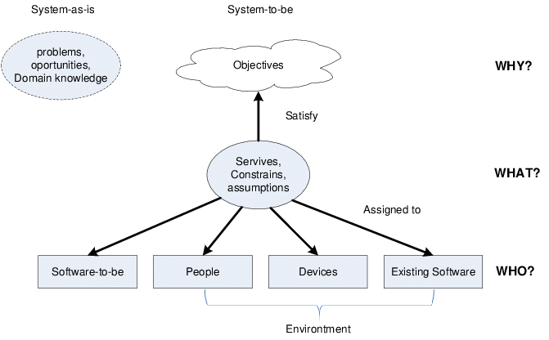

Slide 5
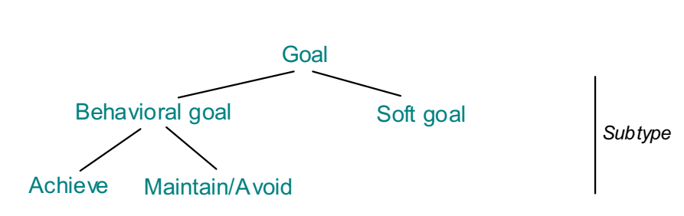
Goals, requirements & expectations
Requirement = goal assigned to single agent in software-to-be
Expectation = goal assigned to single agent in environment
Goal types

Slide 6
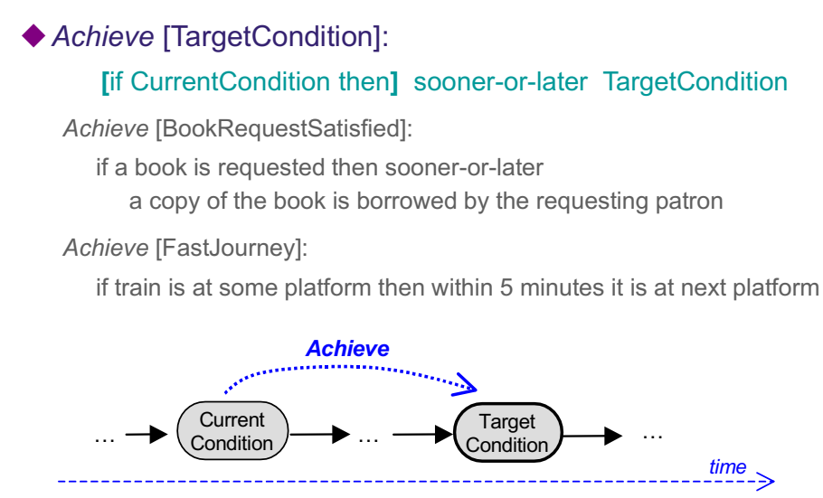
Goals, requirements & expectations
Behavioral goals: subtypes and specification patterns

Slide 7
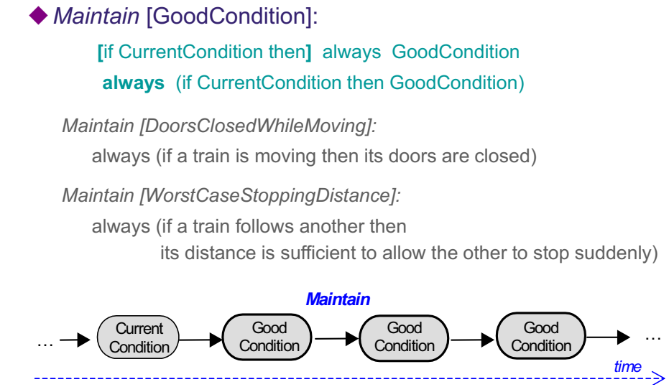
Goals, requirements & expectations

Slide 8
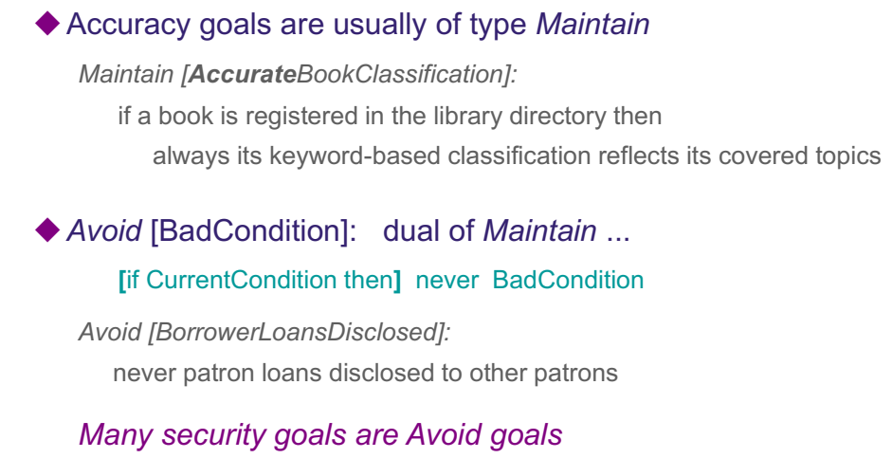
Goals, requirements & expectations

Slide 9
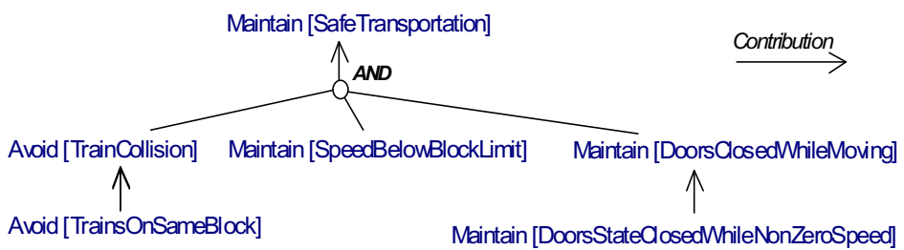
The central role of goals in the RE process
Goal refinement/abstraction as structuring mechanism
– shows contribution links among goals
– drives elaboration of reqs (subgoals)
– provides rationale for reqs (parent goals)
– rich traceability: strategic objectives  technical requirements
– can be used to structure reqs document

Slide 10
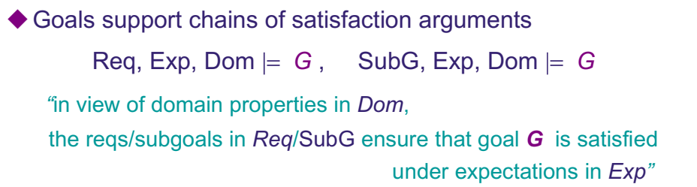
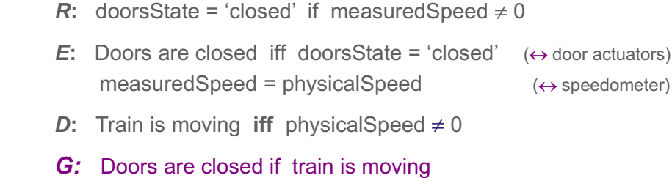
The central role of goals in the RE process

Slide 11
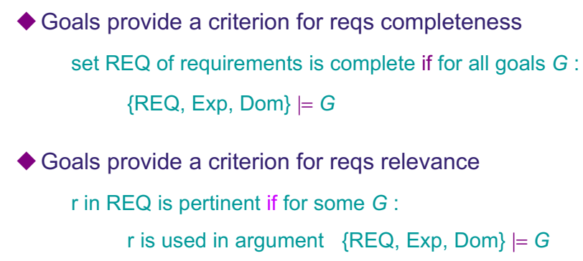
The central role of goals in the RE process

Slide 12
Tóm tắt: các mục tiêu trong bài 7
Các tuyên bố mang tính mô tả về ý định mà hệ thống phải đáp ứng thông qua sự hợp tác của các đại lý của nó
được xây dựng dưới dạng các hiện tượng của thế giới vấn đề
ở nhiều mức độ trừu tượng / chi tiết khác nhau
Có thể được thương lượng, làm suy yếu, hoặc thay đổi
Mục tiêu càng chi tiết, càng ít tác nhân cần thiết để đạt được mục tiêu
yêu cầu, mong muốn: mục tiêu tác nhân đơn lẻ
Mục tiêu hành vi (Đạt được / Duy trì), mục tiêu mềm
Chức năng, chất lượng, mục tiêu phát triển
Notes:
Prescriptive statements of intent the system should satisfy through cooperation of its agents
formulated in terms of problem world phenomena
at various levels of abstraction/granularity
Can be negotiated, weakened, prioritized (unlike domain props)
The finer-grained a goal, the fewer agents required for its satisfaction
requirements, expectations: single-agent goals
Behavioral (Achieve/Maintain) goals, soft goals
Functional, quality, development goals

Slide 13
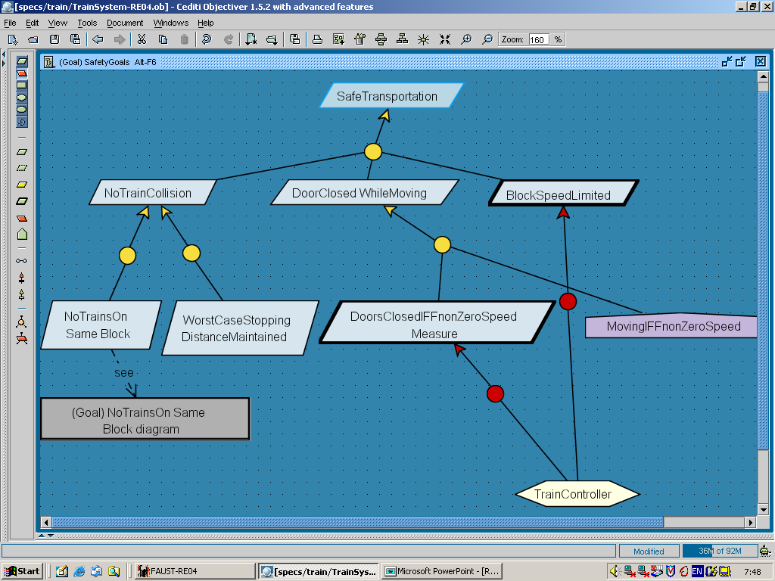
A goal model shows contribution links and leaf goal assignments
AND-refinement
OR-
refinement

Slide 14
Nội dung
Goal features as model annotations
Goal refinement
Capturing conflicts among goals
Connecting the goal model with other system views
Capturing alternative options
Goal diagrams as AND/OR graphs
Documenting goal refinements & assignments with annotations
Building goal models: heuristic rules & reusable patterns
Notes:
Knowledge Acquisition in automated specification
Keep All Objectives Satisfied.

Slide 15
Goal features are specified in model annotations
DoorsClosedWhileMoving
goal
Goal Maintain [DoorsClosedWhileMoving]
Def All train doors shall be kept closed at any time
when the train is moving
[ FormalSpec  in temporal logic for analysis, not in this chapter  ]
[ Category Safety ]
[ Priority Highest ]
[ Source From interview with railway engineer X ... ]
annotation
precise definition
features

Slide 16
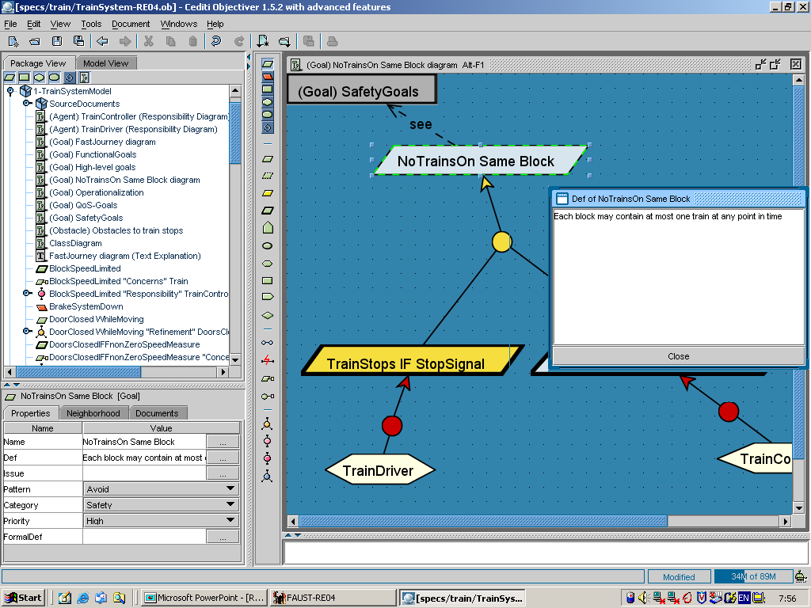

Slide 17
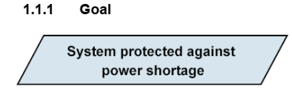
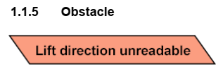
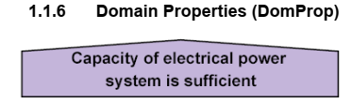
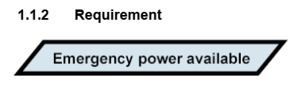
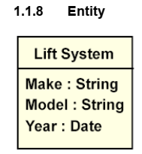
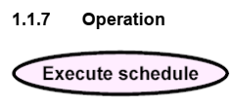
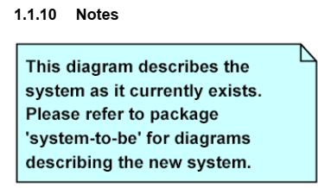
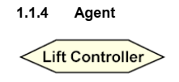
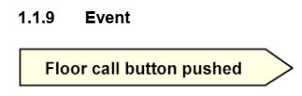
Bộ ký pháp trong Goals-Oriented

Slide 18
Goal refinement
An AND-refinement of goal G into subgoals G₁, ..., G_{n} states that G can be satisfied by satisfying G₁, ..., G_{n}
The set {G₁, ..., G_{n}} is called refinement of G
Subgoal G_{i} is said to contribute positively to G
goal
Achieve [BookRequestSatisfied]
AND-refinement
Achieve [ CopyBorrowed
If Available]
Achieve [CopyDueSoon
If Not Available]
Def In case a requested book has no copy available for check out,
a copy of that book shall be made available within 2 weeks
for check out by the requesting patron.

Slide 19
AND-refinements should be complete
{G₁, ..., G_{n}} is a complete AND-refinement of G iff satisfying G₁, ..., G_{n} is sufficient for satisfying G in view of known domain properties
{G₁, ..., G_{n}, Dom}  G
Achieve [BookRequestSatisfied]
complete AND-refinement (claim)
Achieve [ CopyBorrowed
If Available]
Achieve [CopyDueSoon
If Not Available]
Achieve[ CopyReserved]
Maintain[AvailabilityEnforced]
Achieve[AvailabilityNotified]

Slide 20
Complete AND-refinements
Getting complete refinements of behavioral goals is essential for requirements completeness
Domain properties are often used for arguing about complete refinements
classified as ...
domain invariants: known to hold in every state
"train doors are either open or closed"
domain hypotheses: assumed to hold in specific states
"railway tracks are in good conditions ..."
attached to conceptual objects in the object model

Slide 21
Domain properties in AND-refinements
DoorsClosedWhileMoving
domain
invariant
DoorsClosedWhileNonZeroSpeed
Moving Iff
NonZeroSpeed

Slide 22
AND-refinements should also be consistent and minimal
Consistent: subgoals G₁, ..., G_{n} and domain properties in Dom may not contradict each other:
{G₁, ..., G_{n}, Dom}  false
(any behavior would be permitted from false)
Minimal: if one subgoal G_{j} is missing, the parent goal is no longer necessarily satisfied:
{G₁, ..., G_{j-1}, G_{j+1}, ..., G_{n}, Dom}   G
(to avoid unnecessarily restrictive requirements or expectations)

Slide 23
Refinement trees
Goals are recursively refinable
Leaf nodes = goals assignable to single system agents

Slide 24
Refinement trees visualize satisfaction arguments

Slide 25
Chaining satisfaction arguments into argumentation trees
To show how requirements ensure higher-level concerns, and recursively
MotorRaising 
HandBrakeReleased
req
motor.Regime = ‘up’ 
handBrakeCtrl = ‘off’
motor.Regime = ‘up’  MotorRaising
handBrakeCtrl = ‘off’
HandBrakeReleased

Slide 26
Chaining satisfaction arguments into argumentation trees
To show how requirements ensure higher-level concerns, and recursively
HandBrakeReleased
★ MotorRaising
HandBrakeReleased
→ MotorRaising
MotorRaising 
HandBrakeReleased
req
motor.Regime = ‘up’ 
handBrakeCtrl = ‘off’
motor.Regime = ‘up’  MotorRaising
handBrakeCtrl = ‘off’
HandBrakeReleased

Slide 27
Chaining satisfaction arguments into argumentation trees
To show how requirements ensure higher-level concerns, and recursively
HandBrakeReleased  DriverWantsToStart
HandBrakeReleased
★ MotorRaising
MotorRaising 
AccelerPedalPressed
AccelerPedalPressed
★ DriverWantsToStart
HandBrakeReleased
→ MotorRaising
MotorRaising 
HandBrakeReleased
req
motor.Regime = ‘up’ 
handBrakeCtrl = ‘off’
motor.Regime = ‘up’  MotorRaising
handBrakeCtrl = ‘off’
HandBrakeReleased

Slide 28
Capturing potential conflicts among goals
Goals G₁, ..., G_{n} are divergent in Dom if boundary condition B can be found making them unsatisfiable together:
{B, G₁, ..., G_{n}, Dom}  false
Can be captured for later analysis (cf. Chap. 3, 16, 18 in [RE])

Slide 29
Connecting the goal model with other system views
Interface links relate goals to other sub-models   traceability
Responsibility: instances of Agent are the only ones to restrict behaviors to satisfy Goal
Obstruction: satisfaction of Obstacle inhibits satisfaction of Goal
Concern: specification of Goal refers to Object
0perationalization: spec of Operations ensures satisfaction of Goal
Coverage: behaviors prescribed by Goal cover Scenario
Goal
Agent
Obstacle
Goal
Goal
Object
Goal
Oper1
Oper2
Goal

Slide 30
Goal modeling: outline
Goal features as model annotations
Goal refinement
Capturing conflicts among goals
Connecting the goal model with other system views
Capturing alternative options
Goal diagrams as AND/OR graphs
Documenting goal refinements & assignments with annotations
Building goal models: heuristic rules & reusable patterns

Slide 31
Capturing options: alternative refinements
An OR-refinement of goal G into refinements R₁, ..., R_{m} states that G can be satisfied by satisfying all subgoals from any of the alternative refinements R_{i}
Alternative goal refinements yield different system proposals (variants)
Pros/cons to be evaluated against soft goals for selection of best option

Slide 32
Capturing options: alternative assignments
An OR-assignment of goal G to agents A₁, ..., A_{m} states that G can be satisfied by behavioral restrictions of any of the alternative agents A_{i}
Alternative assignments yield different system proposals
(e.g. different degrees of automation)
Pros/cons to be evaluated against soft goals for selection of best option

Slide 33
Goal diagrams as AND/OR graphs
AND/OR graph shows how goal nodes contribute to each other
roots = high-level system goals
functional or non-functional
behavioral or soft
leaves = requirements or expectations
assignable to single agents
an AND-refinement links a parent goal to set of conjoined subgoals
an OR-refinement links a parent goal to a set of alternative AND-refinements => alternative system options
soft goals in the graph are used to select preferred options
Generally a directed acyclic graph, not a tree
multiple roots (e.g. functional, non-functional goals)
a goal may contribute to multiple parent goals

Slide 34
Goal diagrams as AND/OR graphs (2)
EffectivePassengersTransportation
RapidTransportation
SafeTransportation
AND-refinement
FastJourney
HighFrequency
NoTrainCollision
DoorsClosed
WhileMoving
BlockSpeed
Limited
to-be
system-as-is
OR-refinement
FastRunWhen
GoSignal
SignalSetToGoPromptly
WorstCaseStopping
DistanceMaintained
NoTrainsOn
SameBlock

Slide 35
Goal diagrams as AND/OR graphs (3)
EffectiveAccessToStateOfTheArt
EffectiveLoanSystem
EffectiveBiblioSearchSystem
...
BookRequestSatisfied
Extensive
Coverage
Accurate
Classification
physLib
E-Lib
CopyBorrowed
WhenAvailable
CopyDueSoon
WhenNotAvailable
Effective
BookSupply
E-bookAccess
Copy
Reserved
Availability
Notified
Availability
Enforced
LimitedLoan
Amount
LimitedLoan
Periods

Slide 36
Annotating goal refinements & assignments
Optional features
Name: for unambiguous reference
SysRef: for associating alternatives to system versions
Tactic: for documenting refinement tactic (cf. ref. patterns)

Slide 37
Goal modeling: outline
Goal features as model annotations
Goal refinement
Capturing conflicts among goals
Connecting the goal model with other system views
Capturing alternative options
Goal diagrams as AND/OR graphs
Documenting goal refinements & assignments with annotations
Building goal models: heuristic rules & reusable patterns

Slide 38
Heuristic rules for early discovery of goals
Analyze current objectives & problems in system-as-is ...
preserve strategic, organization-specific objectives & policies
      high-level goals for system-to-be
e.g. Effective access to state-of-the-art knowledge
preserve application-specific objectives to be found in any system version
e.g. Accurate book classification
analyze problems & deficiencies in system-as-is
    goals of system-to-be: Avoid / Reduce / Improve them
e.g. Anywhere anytime biblio search

Slide 39
Heuristic rules for early discovery of goals (2)
Search for goal-related keywords in elicitation material (documents available, interview transcripts, etc.)
intentional: in order to, so as to, so that, purpose, objective, aim, achieve, maintain, avoid, ensure, guarantee, want, motivate, expect,...
prescriptive: shall, should, must, has to, to be, may not, may never,...
amelioration: improve, increase, decrease, reduce, enhance, enable, support, provide, ...
+ refinement links: “in order to X the system has to Y “, ...
(to be checked against false positives)
X
...
Y

Slide 40
Heuristic rules for early discovery of goals (3)
Instantiate goal categories
Browse leaves of taxonomies of functional & non-functional goals, looking for system-specific instances
e.g. Any Information goal concerning train passengers?
Any Accuracy goal about train information?
Any Confidentiality goal about meeting participants?

Slide 41
Heuristic rules for later discovery of goals
By abstraction (bottom-up): ask WHY? questions about...
- lower-level goals
- interaction scenarios being elicited
- other operational material available
=> parent goals
By refinement (top-down): ask HOW? questions about ...
- higher-level-goals
=> subgoals
Frequent questioning patterns
WHY? directly followed by HOW? on parent goal, to elicit missing “brothers”
HOW ELSE? to explore alternatives

Slide 42
Building goal models: HOW and WHY questions
BookRequestSatisfied
HOW?
CopyBorrowed
WhenAvailable
CopyDueSoon
WhenNotAvailable
Copy
Reserved
Availability
Notified
Availability
Enforced
WHY?
LimitedLoan
Amount
LimitedLoan
Periods

Slide 43
Building goal models: HOW and WHY questions
EffectivePassengersTransportation
HOW?
RapidTransportation
SafeTransportation
FastJourney
HighFrequency
NoTrainCollision
DoorsClosed
WhileMoving
BlockSpeed
Limited
S2B
current
WHY?
FastRunWhen
GoSignal
SignalSetToGoPromptly
WorstCaseStopping
DistanceMaintained
NoTrainsOn
SameBlock

Slide 44
Identifying goals from WHY questions about scenario episodes

Slide 45
Heuristic rules for later discovery of goals (2)
Split responsibilities among agents
to get subgoals involving fewer agents
and move towards requirements and expectations

Slide 46
Heuristic rules for later discovery of goals (3)
Identify soft goals from pros & cons of alternative options
pro => refinement link to missing parent soft goal ?
con => conflict link to missing parent soft goal ?

Slide 47
Heuristic rules for later discovery of goals (4)
Identify wishes of human agents
e.g. MinimalRequirementsOnParticipants
Check the converse of Achieve goal for missing Maintain goal
Achieve [Target If Condition]:
if Condition then sooner-or-later Target
?   ?
Maintain [Target OnlyIf Condition]:
always (if Target then Condition)
e.g. Achieve [ItemSent If Paid]   Maintain [ItemSent OnlyIf Paid]
Achieve [reverseThrustEnabled If PlaneOnGround]
→ Maintain [reverseThrust OnlyIf PlaneOnGround]

Slide 48
Building goal models: delimiting their scope
Refine goals … until when ?
... until assignable to single agents as ...
requirement (software agent)
expectation (environment agent)
Abstract goals … until when ?
... until boundary of system capabilities is reached:
goals that cannot be satisfied solely by system agents
e.g. EliminateGreenhouseEffect
is beyond capabilities of train system

Slide 49
Goal refinement … until when ?
Maintain[WC-SafeDistanceBetwTrains]
Maintain [Safe
Speed/AccelCom'ed]
Maintain [Safe
TrainRespToComd]
...

Slide 50
Goal refinement … until when ?
Maintain[WC-SafeDistanceBetwTrains]
Maintain[Safe
Speed/AccelCom'ed]
Maintain[Safe
TrainRespToComd]
...
OnBoard
TrainControl

Slide 51
Goal refinement … until when ?
Maintain[WC-SafeDistanceBetwTrains]
Maintain[Safe
Speed/AccelCom'ed]
Maintain[Safe
TrainRespToComd]
...
OnBoard
TrainControl
Mt[AccurateEstimate
OfSpeed/Position]
Mt[SafeComdTo
NextTrainFromEstim]

Slide 52
Goal refinement … until when ?
Maintain[WC-SafeDistanceBetwTrains]
Maintain[Safe
Speed/AccelCom'ed]
Maintain[Safe
TrainRespToComd]
...
OnBoard
TrainControl
Mt[AccurateEstimate
OfSpeed/Position]
Mt[SafeComdTo
NextTrainFromEstim]
Tracking
System

Slide 53
Goal refinement … until when ?
Maintain[WC-SafeDistanceBetwTrains]
Maintain[Safe
Speed/AccelCom'ed]
Maintain[Safe
TrainRespToComd]
...
OnBoard
TrainControl
Mt[AccurateEstimate
OfSpeed/Position]
Mt[SafeComdTo
NextTrainFromEstim]
Tracking
System
Achv[ComdMsg
SentInTime]
Mt[Safe
ComdMsg]
Achv[SentMsg
DeliveredInTime]
Mt[Msg
Implem]

Slide 54
Goal refinement … until when ?
Maintain[WC-SafeDistanceBetwTrains]
Maintain[Safe
Speed/AccelCom'ed]
Maintain[Safe
TrainRespToComd]
...
OnBoard
TrainControl
Mt[AccurateEstimate
OfSpeed/Position]
Mt[SafeComdTo
NextTrainFromEstim]
Tracking
System
Achv[ComdMsg
SentInTime]
Mt[Safe
ComdMsg]
Achv[SentMsg
DeliveredInTime]
Mt[Msg
Implem]
Speed/Accel
Control

Slide 55
Goal refinement … until when ?
Maintain[WC-SafeDistanceBetwTrains]
Maintain[Safe
Speed/AccelCom'ed]
Maintain[Safe
TrainRespToComd]
...
OnBoard
TrainControl
Mt[AccurateEstimate
OfSpeed/Position]
Mt[SafeComdTo
NextTrainFromEstim]
Tracking
System
Achv[ComdMsg
SentInTime]
Mt[Safe
ComdMsg]
Achv[SentMsg
DeliveredInTime]
Mt[Msg
Implem]
Speed/Accel
Control
Communic
Infrastruct

Slide 56
Goal refinement … until when ?
Maintain[WC-SafeDistanceBetwTrains]
Maintain[Safe
Speed/AccelCom'ed]
Maintain[Safe
TrainRespToComd]
...
OnBoard
TrainControl
Mt[AccurateEstimate
OfSpeed/Position]
Mt[SafeComdTo
NextTrainFromEstim]
Tracking
System
Achv[ComdMsg
SentInTime]
Mt[Safe
ComdMsg]
Achv[SentMsg
DeliveredInTime]
Mt[Msg
Implem]
Speed/Accel
Control
Communic
Infrastruct

Slide 57

Building goal models: bad smells
Do not confuse ...
goal ...
operation ...
Goal  service from functional model (e.g. use case)
Services operationalize functional, leaf goals in refinement graph
a goal is often operationalized through multiple operations
an operation often operationalizes multiple goals
Soft goals are often not operationalized in functional model but used to select among alternatives
CopyBorrowed
IfAvailable
DoorsOpen
OnlyIf TrainStopped
Open
Doors
BorrowCopy

Slide 58

Behavioral goals vs. operations
Semantic difference
Behavioral goals constrain entire sequences of state transitions
Operations constrain single state transitions
Tip: use past participle for goal name
(state to be reached/maintained, quantity to be reduced/increased, ...)
use infinitive for operation name
(action to reach/maintain that state)

Slide 59

Building goal models: bad smells (2)
Do not confuse ...
OR-refinement ...
AND-refinement by case ...
cf. case analysis:
(Case1 or Case2)  X equiv (Case1  X) and (Case2  X)
OR-refinement introduces alternative systems to reach parent goal
AND-refinement by cases introduces complementary, conjoined subgoals within same system
Extensive
Coverage
physLib
E-Lib
Effective
BookSupply
E-bookAccess
BookRequestSatisfied
CopyBorrowed
If Available
CopyDueSoon
If Not Available

Slide 60

Building goal models: bad smells (3)
Avoid ambiguities in goal specification & interpretation ...
a precise & complete goal definition is essential
grounded on shared system phenomena, and agreed upon by all stakeholders
Def A train shall never get so close to a train in front so that if the train stops suddenly (e.g., derailment) the next train would hit it
WorstCaseStopping
DistanceMaintained
BookRequestSatisfied
Def A book without any copy available for loan shall have a copy available within 15 days for the requesting borrower
CopyDueSoon
WhenNotAvailable

Slide 61
Building goal models: reuse refinement patterns
From a catalogue of generic, complete AND-refinements ...
encode refinement tactics, codify modeller’s experience
guide modeling process by suggesting refinements to be instantiated
instantiated pattern may sometimes require adaptation
provide satisfaction argument for free
(formal) correctness proof done once for all, kept hidden
support model documentation & understanding
can also be used for ...
completing partial refinements
exploring alternative options (multiple applicable patterns)

Slide 62
A sample of refinement patterns
Refinement by milestone
Applicable when milestone states can be identified on the way to the goal's target condition
Example of use:
milestone-driven refinement

Slide 63
Refinement by milestone: variant for Maintain goals
milestone-driven refinement
SafeTrainAccelerationGuaranteed
ReceivedCommand
ExecutedByTrain
SafeAcceleration
Computed
AccelerationSent
InTimeToTrain
SentCommand
ReceivedByTrain

Slide 64
A sample of refinement patterns (2)
Refinement by case
Applicable when the goal satisfaction space can be partitioned into cases (disjoint, covering all possibilities)
Achieve [Target]
Case1 or Case2
not (Case1 and Case2)
Achieve [Target1
If Case1]
Achieve [Target2
If Case2]
if Target1
or Target2
then Target
Example of use:
(Similar pattern for Maintain goals)
BookRequestSatisfied
case-driven refinement
CopyBorrowed
If Available
CopyDueSoon
If Not Available

Slide 65
A sample of refinement patterns (3)
Guard introduction
Applicable to Achieve goals where a guard condition must be set for reaching the target
Example of use:
guard introduction

Slide 66
A sample of refinement patterns (4)
Divide-and-Conquer
Applicable to Maintain goals where GoodCondition is a conjunction
Example of use:
divide-and-conquer

Slide 67
A sample of refinement patterns (5)
Refinement towards goal realizability
Applicable when the goal refers to quantities not monitorable or not controllable by candidate agent
GoalOnUnMonitorableCondition
resolve lack of monitorability
GoalOnMonitorable
Condition
MonitorableCondition Iff
UnMonitorableCondition
GoalOnUnControllableCondition
resolve lack of controllability
GoalOnControllable
Condition
ControllableCondition Iff
UnControllableCondition
Child node may be goal (incl. requirement, expectation)
or domain property (invariant/hypothesis)

Slide 68
Refinement towards goal realizability: examples of use
DoorsClosedWhileMoving
resolve lack of monitorability
DoorsClosedWhileNonZeroSpeed
NonZeroSpeed
Iff Moving
domain invariant
NurseIntervention If CriticalPuseRate
resolve lack of controllability
NurseIntervention
If Alarm
Alarm Iff
CriticalPulseRate
expectation
requirement

Slide 69
Refinement towards goal realizability: examples of use (2)
GoalOnUnMonitorableCondition
GoalOnMonitorable
Condition
MonitorableCondition 
UnmonitorableCondition
instantiation
MotorRaising  HandBrakeReleased
motor.Regime = ‘up’ 
HandBrakeReleased
motor.Regime = ‘up’
★ MotorRaising

Slide 70
Refinement towards goal realizability: examples of use (3)
GoalOnUnControllableCondition
GoalOnControllable
Condition
ControllableCondition 
UncontrollableCondition
instantiation
motor.Regime = ‘up’  HandBrakeReleased
motor.Regime = ‘up’ 
handBrakeCtrl = ‘off’
handBrakeCtrl = ‘off’
 HandBrakeReleased
req

Slide 71
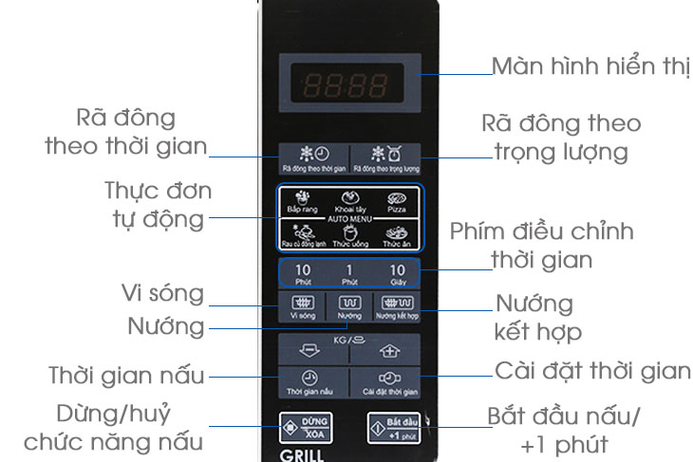
Bài tập Sử dụng kỹ thuật Goal- Oriented
Lò vi sóng

Slide 72
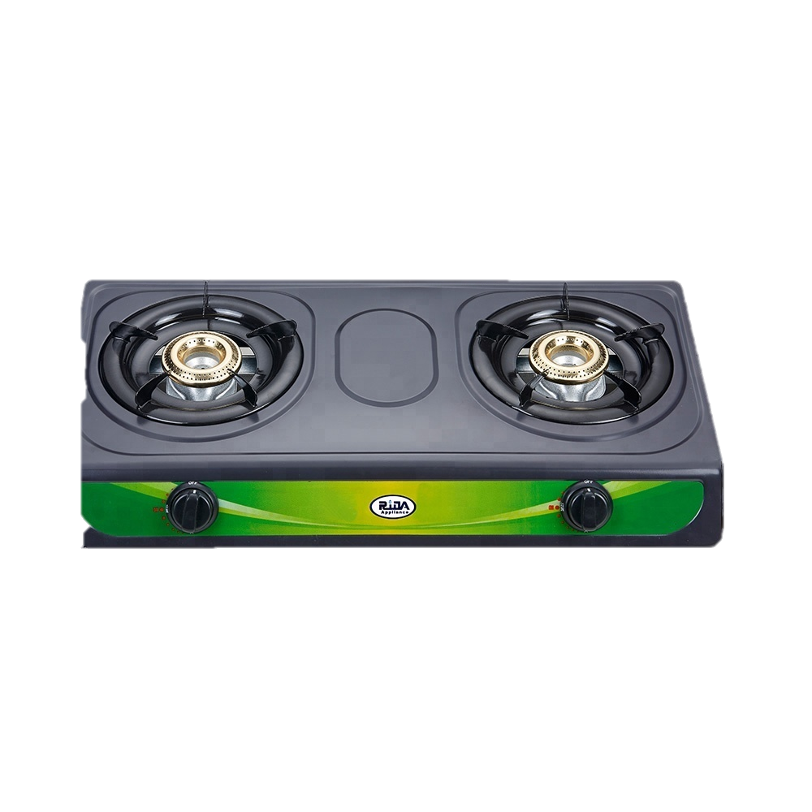
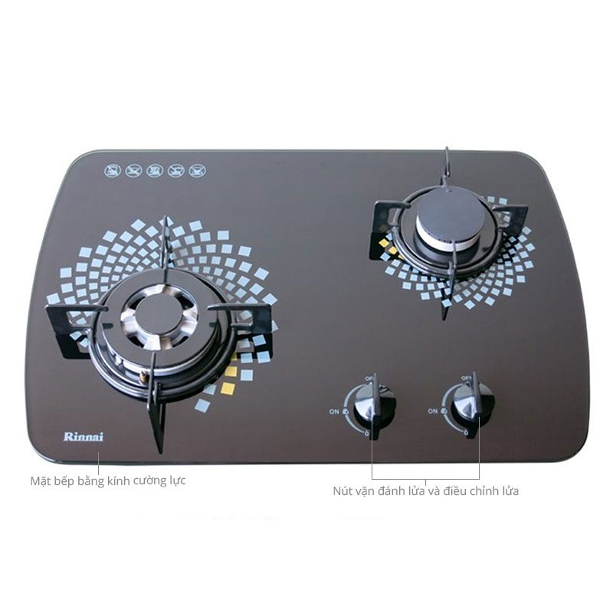
Bài tập Sử dụng kỹ thuật Goal- Oriented
Bếp ga

Slide 73

Bài tập Sử dụng kỹ thuật Goal- Oriented
Bếp từ

